Slide 1
AI for Everyone
Presidential Initiative for Artificial Intelligence and Computing

Slide 2
Objectives of this Course
The meaning behind common AI terminology, including neural networks, machine learning, deep learning, and data science
What AI realistically can--and cannot--do
How to spot opportunities to apply AI to problems in your own organization
What it feels like to build machine learning and data science projects
How to work with an AI team and build an AI strategy in your company
How to navigate ethical and societal discussions surrounding AI

Slide 3
$13 Trillion
AI value creation by 2030
Source: McKinsey Global Institute

Slide 4
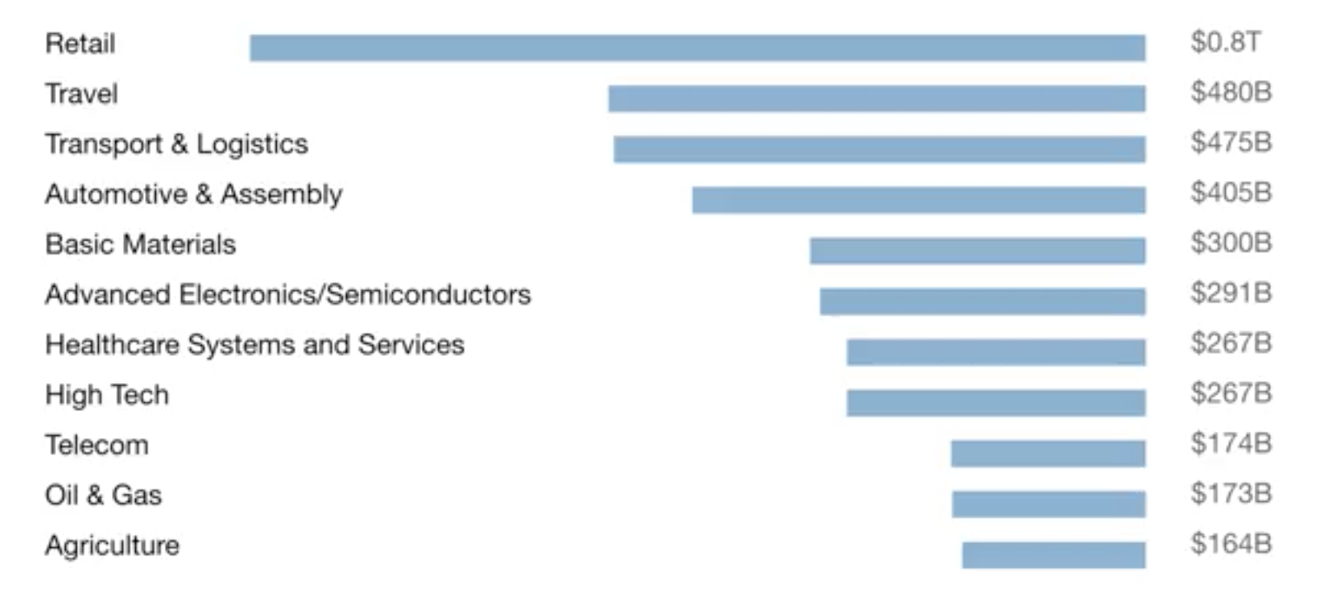
A lot of the value created by AI will be outside the software industry. AI will have a huge impact on all the major industries.

Slide 5
There are 2 types of AI
ALMOST NO PROGRESS
ANI
Artificial Narrow Intelligence
AGI
Artificial General Intelligence
LOTS OF PROGRESS
Notes:
There is a lot of excitement but also a lot of unnecessary hype about AI.
AI is actually two separate ideas.

Slide 6
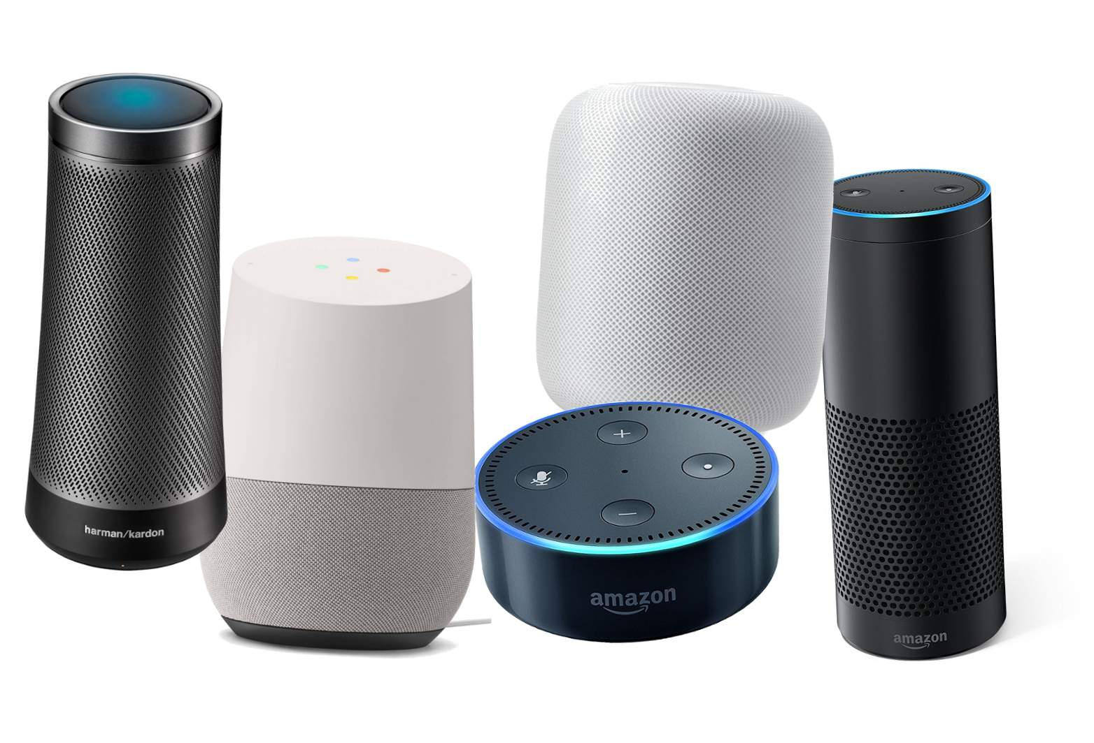
Artificial Narrow Intelligence (ANI)
These are AIs that do one thing such as:
smart speaker
self-driving car
AI to do web search
AI applications in farming or in a factory.
These types of AI are one trick ponies but when you find the appropriate trick, this can be incredibly valuable.

Slide 7

Artificial General Intelligence (AGI)
That is the goal to build AI.
They can do anything a human can do or maybe even be superintelligent and do even more things than any human can.

Slide 8
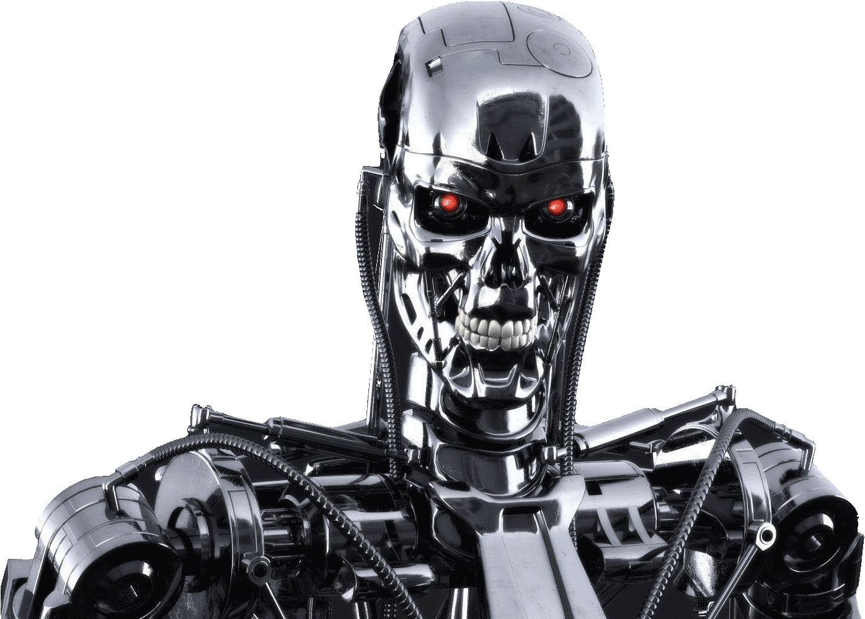
Progress in ANI vs AGI
The rapid progress in ANI has caused people to conclude that there's a lot of progress in AI, which is true. But that has caused people to falsely think that there might be a lot of progress in AGI as well which is leading to some irrational fears about evil clever robots coming over to take over humanity anytime now.

Slide 9
Achieving AGI Will Take Time
AGI is an exciting goal for researchers to work on, but it requires many technological breakthroughs before we get there and it may be decades or hundreds of years or even thousands of years away.

Slide 10
Machine Learning
The rise of AI has been largely driven by one tool in AI called machine learning.
You will start thinking how machine learning might be applied to your company or to your industry.

Slide 11



Supervised Learning
If the input is an audio clip, and the AI's job is to output the text transcript, then this is speech recognition.
Input (A)
Audio
Output (B)
Text (0/1)
Application
Speech Recognition

Slide 12



Supervised Learning
If you want to input English and have it output a different language, Chinese, Spanish, something else, then this is machine translation.
Input (A)
English
Output (B)
Chinese
Application
Machine Translation

Slide 13




Supervised Learning
All the large online ad platforms have a piece of AI that inputs some information about an ad, and some information about you, and tries to predict, will you click on this ad or not?
Input (A)
Ad + User Info
Output (B)
Click? (0/1)
Application
Machine Translation

Slide 14


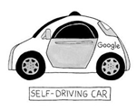

Supervised Learning
If you want to build a self-driving car, one of the key pieces of AI is the AI that takes as input an image, and some information from radar, or from other sensors, and outputs the position of other cars, so your self-driving car can avoid the other cars.
Input(A)
Image, radar info
Position of other cars
Self-Driving Car

Slide 15


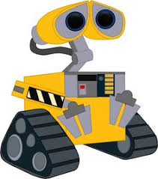
Supervised Learning
In Manufacturing, we take as input a picture of something you've just manufactured, such as a picture of a cell phone coming off the assembly line., and you want to output, is there a scratch, or is there a dent, or some other defects on this thing you've just manufactured? This is visual inspection which is helping manufacturers to reduce or prevent defects in the things that they're making.
Input (A)
Image of a phone
Output (B)
Defects (0/1)
Visual Inspection

Slide 16
Supervised Learning
This set of AI called supervised learning, just learns input to output, or A to B mappings. On one hand, input to output, A to B it seems quite limiting. But when you find a right application scenario, this can be incredibly valuable.

Slide 17
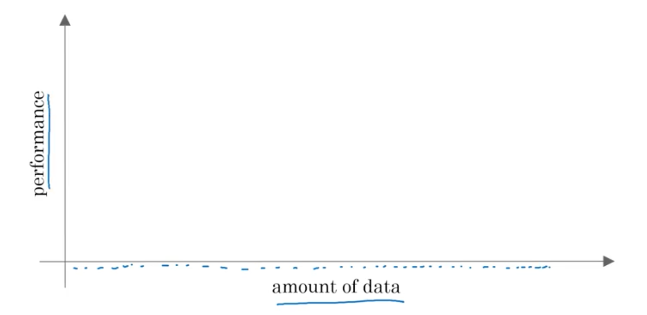
Why Now?

Slide 18
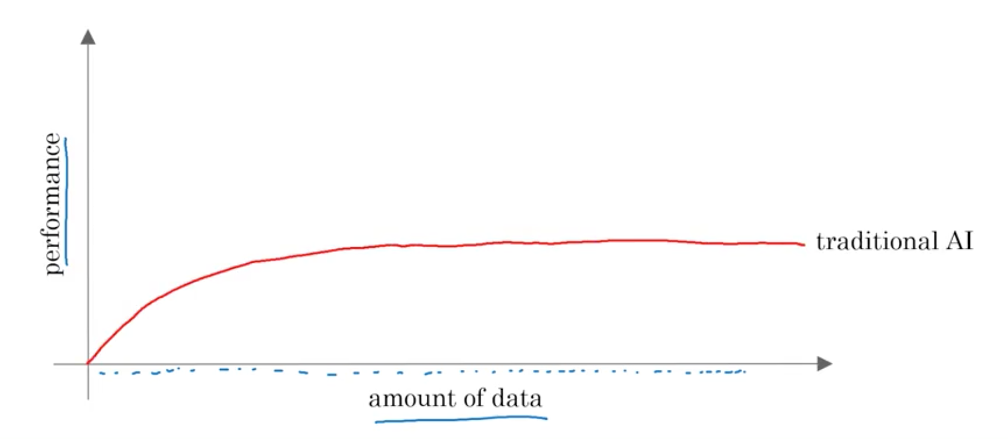
Why Now?

Slide 19
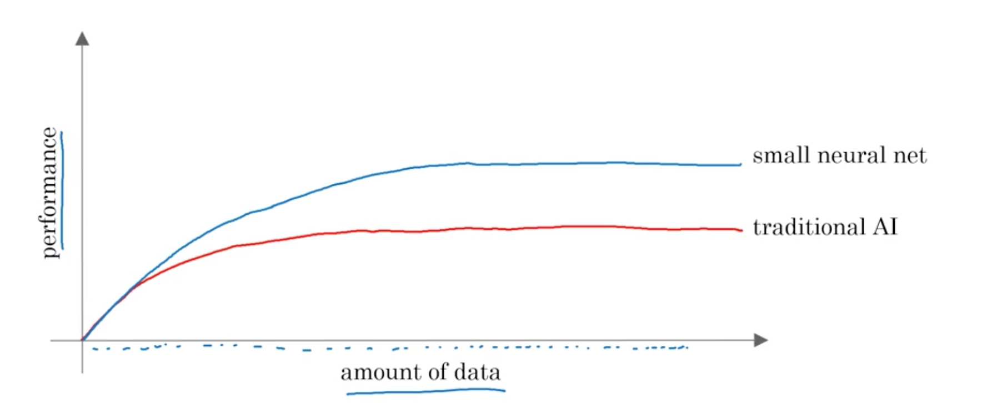
Why Now?

Slide 20
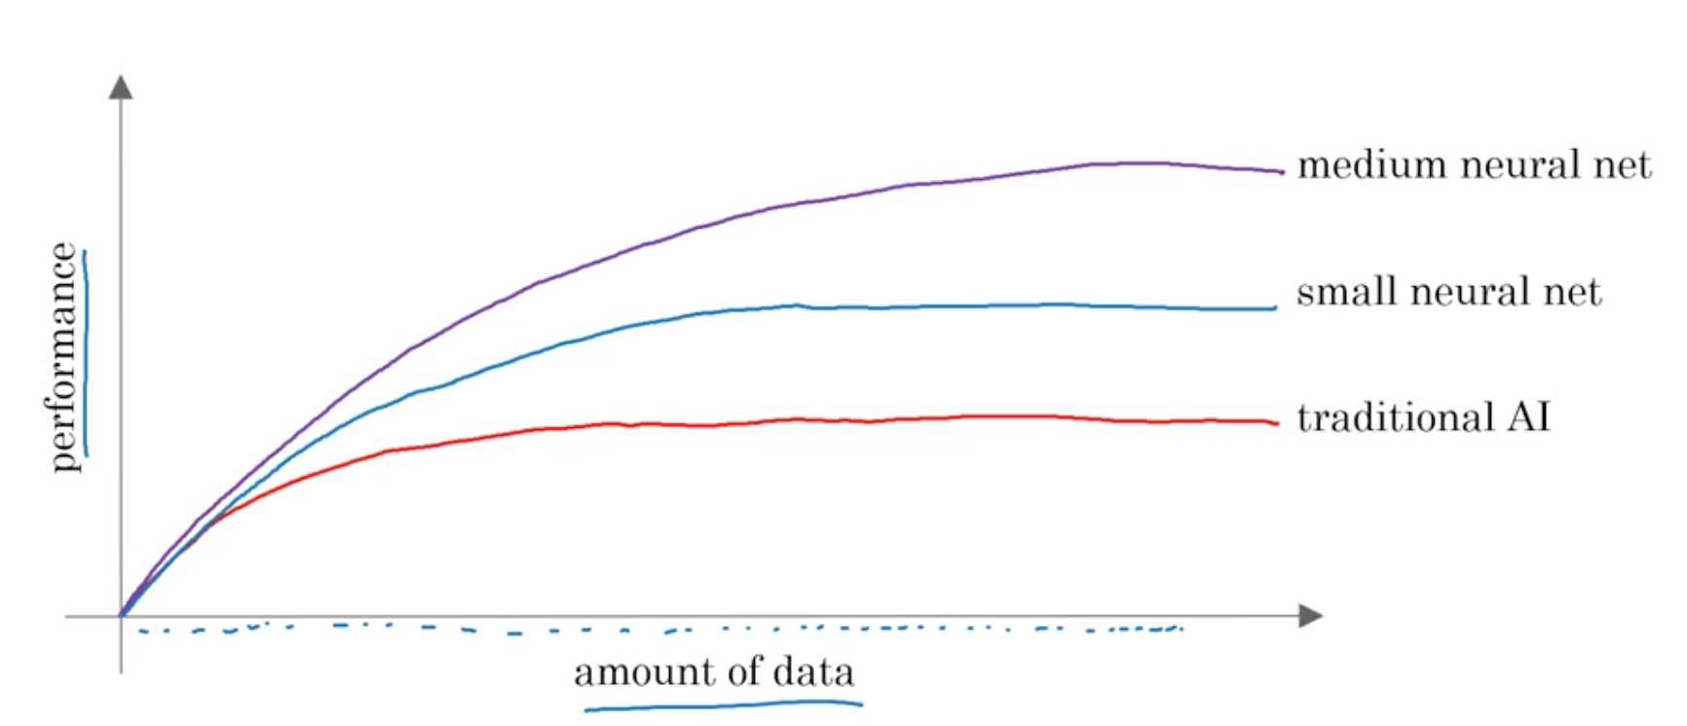
Why Now?

Slide 21
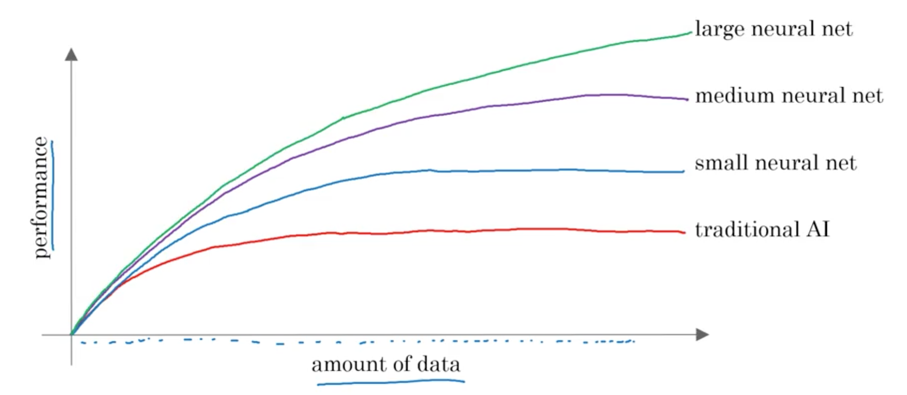
Why Now?

Slide 22
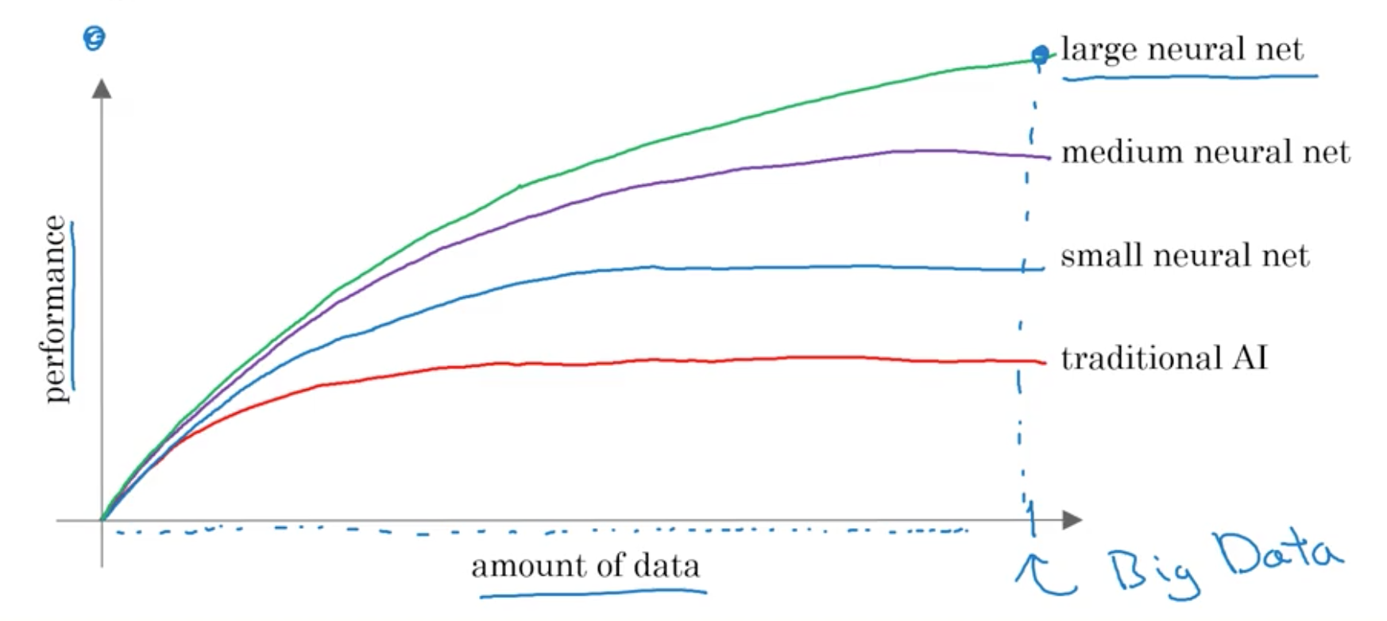
Why Now?

Slide 23
The Rise of Fast Computers
So, the rise of fast computers with specialized processors such as graphics processing units or GPUs has enabled many companies, not just giant tech companies, but many many other companies to be able to train large neural nets on a large enough amount of data in order to get very good performance and drive business value.

Slide 24
What is the most important
idea in AI?

Slide 25
Machine Learning

Slide 26
What is Supervised Learning?

Slide 27
A to B mappings
Input to Output mappings

Slide 28
What enables machine learning
to work so well?

Slide 29
What is Data

Slide 30
A Table of Data (Dataset)
Size of House (Square Feet) | Price ($1000)
523 | 115
645 | 150
708 | 210
1034 | 280
2290 | 355
2545 | 440
A | B

Slide 31
A Table of Data (Dataset)
Size of House (Square Feet) | # of Bedrooms | Price ($1000)
523 | 1 | 115
645 | 1 | 150
708 | 2 | 210
1034 | 3 | 280
2290 | 4 | 355
2545 | 4 | 440
A |  | B

Slide 32
Data is often unique to your business
Data is often unique to your business, and this is an example of a dataset that a real estate agency might have that they tried to help price houses.
It's up to you to decide what is A and what is B, and how to choose these definitions of A and B to make it valuable for your business.

Slide 33
Another example
If you have a certain budget and you want to decide what is the size of house you can afford, then you might decide that the input A is how much does someone spend and B is just the size of the house in square feet, and that would be a totally different choice of A and B that tells you, given a certain budget, what's the size of the house you should be maybe looking at.

Slide 34
A Table of Data (Dataset)
Size of House (Square Feet) | # of Bedrooms | Price ($1000)
523 | 1 | 115
645 | 1 | 150
708 | 2 | 210
1034 | 3 | 280
2290 | 4 | 355
2545 | 4 | 440
B |  | A

Slide 35

Acquiring data
Manual labeling

Slide 36
Acquiring data
From observing behaviors of humans
User ID | Time | Price ($) | Purchased
4783 | Jan 21 08:15.20 | 7.95 | yes
3893 | Mar 3 11:30.15 | 10.00 | yes
8384 | Jun 11 14:15.05 | 9.50 | no
0931 | Aug 2 20:30.55 | 12.90 | yes

Slide 37
Acquiring data
From observing behaviors of machines
Machine | Temperature | Pressure (psi) | Machine Fault
17987 | 60 | 7.65 | N
34672 | 100 | 25.50 | N
08542 | 140 | 75.50 | Y
98536 | 165 | 125 | Y
Input A |  |  | Input B

Slide 38
Acquiring data
Download from websites / partnerships
Thanks to the open internet you can find so many datasets available for free online
Computer vision or image datasets
Self driving car datasets
Speech recognition datasets
Medical imaging datasets
Keep in mind licensing and copyright

Slide 39


Use and misuse of data
Give me three years to build up my IT team, we're collecting so much data.
Then after three years, I'll have this perfect dataset.
We'll do AI then.
What’s wrong with this approach?

Slide 40
Use and misuse of data
It turns out that's a really bad strategy.
Once you've started collecting some data, go ahead and start showing it or feeding it to an AI team.
Then the AI team can give feedback to your IT team on what types of data to collect and what types of IT infrastructure to keep on building.

Slide 41
Example
Maybe an AI team can look at your factory data and say, "Hey. You know what? If you can collect data from this big manufacturing machine, not just once every ten minutes, but instead once every one minute, then we could do a much better job building a preventative maintenance systems for you.”
Machine | Temperature | Pressure (psi) | Machine Fault
17987 | 60 | 7.65 | N
34672 | 100 | 25.50 | N
08542 | 140 | 75.50 | Y
98536 | 165 | 125 | Y
Input A |  |  | Input B

Slide 42
Use and misuse of data
"Hey, I have so much data. Surely, an AI team can make it valuable."
What’s wrong with this statement?

Slide 43
Use and misuse of data
Unfortunately, this doesn't always work out.
More data is usually better than less data, but I wouldn't take it for granted that just because you have many terabytes or gigabytes of data, that an AI team can actually make that valuable.
Don't throw data at an AI team and assume it will be valuable.

Slide 44
Data is Messy
Not a cat
Not a cat
Cat
Cat

Slide 45

Data is Messy
If you have bad data, then the AI will learn inaccurate things.
Data problems:
Incorrect labels
Missing values
Multiple types of data
Unstructured Data: Images, audio, text

Slide 46
Example
Size of House (Square Feet) | # of Bedrooms | Price ($1000)
523 | 1 | 115
645 | 1 | 0.001
708 | unknown | 210
1034 | 3 | unknown
unknown | 4 | 355
2545 | unknown | 440
You can have incorrect labels or just incorrect data. For example, this house is probably not going to sell for $0.1 just for one dollar.
Or, data can also have missing values such as we have here a whole bunch of unknown values.
This is structured data.

Slide 47
Machine Learning vs Data Science
Size of House (Square Feet) | # of Bedrooms | # of Bathrooms | Newly Renovated | Price ($1000)
523 | 1 | 2 | N | 115
645 | 1 | 3 | N | 150
708 | 2 | 1 | N | 210
1034 | 3 | 3 | Y | 280
2290 | 4 | 4 | N | 355
2545 | 4 | 5 | Y | 440
A |  |  |  | B
Notes:
Mobile App to help people price houses
Machine Learning system: A > B

Slide 48
Running AI System
A software that which automatically returns output B for input A.
If you have an AI system running, serving dozens or hundreds of thousands or millions of users, that's usually a machine-learning system.

Slide 49
Data Science
If you want to have a team analyze your dataset in order to gain insights. The output of a data science project is a set of insights that can help you make business decisions
So, a team might come up with conclusions like:
"Hey, did you know if you have two houses of a similar size, they've a similar square footage, if the house has three bedrooms, then they cost a lot more than the house of two bedrooms, even if the square for this is the same."

Slide 50
Data Science
"Did you know that newly renovated homes have a 15% premium, and this can help you make decisions such as, given a similar square footage, do you want to build a two bedroom or three bedroom size in order to maximize value? "
"Is it worth an investment to renovate a home in the hope that the renovation increases the price you can sell a house for?"
The output of a data science project is a set of insights that can help you make business decisions, such as what type of house to build or whether to invest in renovation.

Slide 51
Machine Learning vs Data Science
Machine Learning
“Field of study that gives computers the ability to learn without being explicitly programmed.”
Arthur Samuel (1959)
A machine learning project will often result in a piece of software that runs, that outputs B given A.

Slide 52
Formal Definition of Data Science
Data science is the science of extracting knowledge and insights from data.
So, the output of a data science project is often a slide deck, the presentation summarizes conclusions for executives to take business actions or summarizes conclusions for a product team to decide how to improve a website.

Slide 53
Example of ML vs DS in the online ad industry
Large platforms have AI that quickly tells them what’s the ad you’re most likely to click on. This is a machine learning system. It inputs information about the user and about the ad and outputs whether the user will click on the ad or not.
These systems run 24/7 and drive ad revenue for these platforms.

Slide 54
Example of ML vs DS in the online ad industry
If analyzing data tells you, for example, that the travel industry is not buying a lot of ads, but if you send more salespeople to sell ads to travel companies, you could convince them to use more advertising, then that would be an example of a data science project.
The data science conclusion results in the executives deciding to ask a sales team to spend more time reaching out to the travel industry.

Slide 55
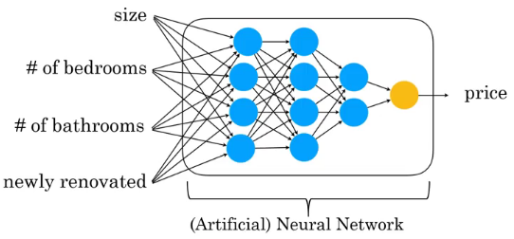
Deep Learning

Slide 56
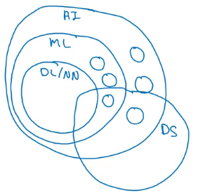
AI and related disciplines
Machine Learning
Data Science
Deep Learning / Neural Network
Supervised Learning
Un supervised learning
Reinforcement Learning

Slide 57
What makes a company AI company?
Strategic data acquisition
Unified datawarehouse
Pervasive automation
New roles such as MLE
Notes:
To kya hr company AI company hai ? Ya bn skti hai…?
Revise old symbolic, ML, AI definitions, SL,DL,USL, NN,
Ya AI company ki kya characteristics hain?
Acha Internet companies?? Facebook, amazon, daraz
Acha AI ko implement krny k liye kya chahye sbsy phly? The most important thing jisky baghair its not possible→

Slide 58
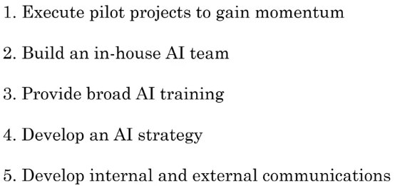
AI Transformation
Notes:
AI transformation playbook by Landing AI. ->Andrew NG
AI Strategy→ virtuous cycle of AI(→unmonetized strategies—10 years challenge→if you are not buying any product, you are the product.
Free products→
Communications→for alignment-everyone working collaboratively toward a common goal→make employees take decisions inline with the org’s goals.→sharing of info.
Explaining a clear value creation thesis for AI in your company, describing your growing AI capabilities, and finally having a thoughtful AI strategy, will help investors value your company appropriately.
Companies in highly regulated industries (self-driving cars, healthcare) face unique challenges to stay compliant
Customer/User Education:
Many employees are also concerned about their jobs being automated by AI,
Succeed in an AI powered future

Slide 59
Deciding about a new project
Technical diligence
Is it feasible project?
Can AI do that?
Pretty much any thing you can do with a second of thought can be automated using supervised learning

Slide 60
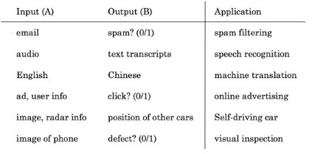
Supervised learning tasks

Slide 61
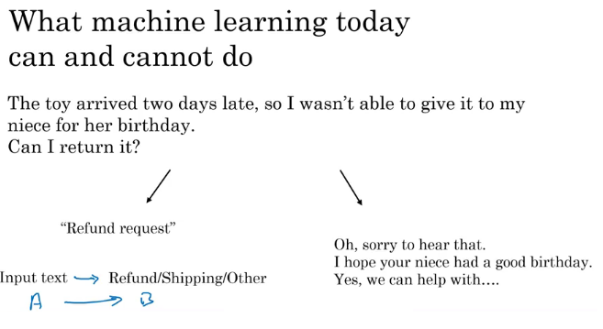

Slide 62
Examples of what ML can and can’t do?
Identifying the intent of the customer - Possible
Writing an emphatic response to customer’s email – Not possible or difficult

Slide 63
Technical diligence rules
You are learning a simple concept
Do you have large training data

Slide 64
More examples
Self driving car
Input is from sensors, camera
Output where are the other cars
Recognizing gesture of traffic police, construction work, people– not possible
Critical application requires good accuracy

Slide 65
X-ray diagnosis
Diagnosing a disease from X-ray images– possible
Diagnosing a disease after reading a book

Slide 66
Strengths and weakness of ML
Works when,
Learning a simple concept
Lots of data available
Doesn’t work when,
Learning a complex concept
Asked to work on new type of data such as X-ray images in different conditions and angles

Slide 67
Demand prediction based on price
Price -> Demand can be modeled using a neural network using a neuron
(Perceptron model)
Network of neurons (ANN)
Price
Shipping Cost
Marketing
Meterial
Notes:
Project like this→ Iphone→

Slide 68
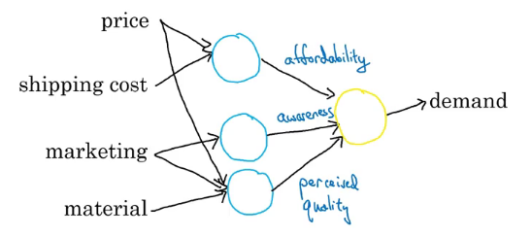

Slide 69
Face recognition
Pictures comprise pixels
Color images and channels
A neural network corresponds to pixels
Earlier layers will detect edges, then lobes and then objects

Slide 70
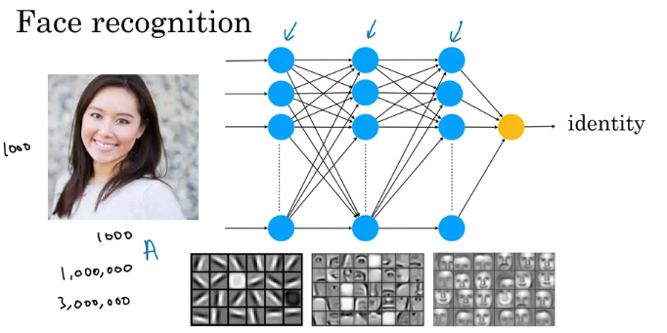

Slide 71
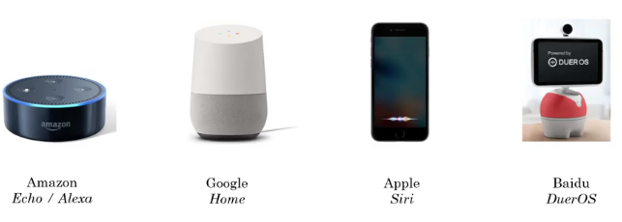
Speech Recognition

Slide 72
Key steps of Echo / Alexa
Collect data
Labelled voice
Train model
Iterate many times
Deploy the model
Get more data and update model
Notes:
Play,

Slide 73
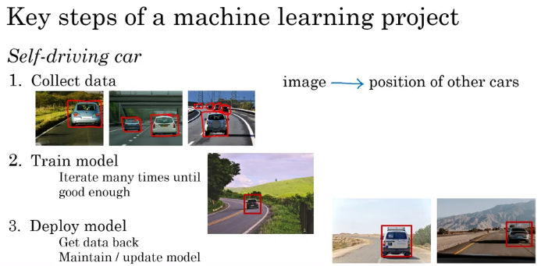

Slide 74
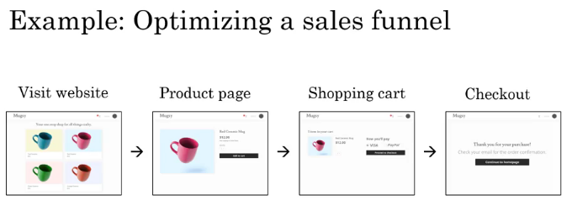

Slide 75
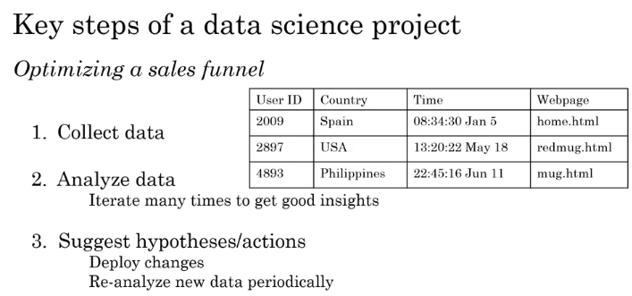
Notes:
Expolatory analysis→ graphical representation between different columns
Statistical analysis→ mean, median, mode, probs, corealtion,

Slide 76
Machine Learning changing job functions
Sales
Identifying sales opportunities
Prioritizing
Manufacturing line manager
Optimize manufacturing
Machine learning can spot defects
Recruiting
Identify how people prefer recruitment
Spot good candidates

Slide 77
Marketing
Optimize website
A/B testing
Recommendation system
Agriculture
What to plant?
Precision agriculture

Slide 78
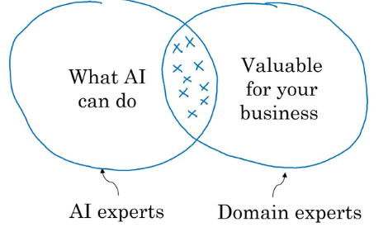
How to chose an AI project?
Notes:
Example: real estate: house → price prediction, user prediction
Shop opening→

Slide 79
Brainstorming framework
Automate task rather than job
Automating call center: picking phone, emails, issue refund, call routing
Automating radiologist: X-ray, mentoring other doctors, consulting,
Main drivers of business value
What are the main pain points in your business?
Notes:
Automate→two Q’s →most business drive→ product
Most painful→ costly

Slide 80
Is it always necessary to have big data?
Having more data is good
With small datasets you can make progress
10, 100 or 1000 data points can be a good start
Notes:
Sample froms In a shop.

Slide 81
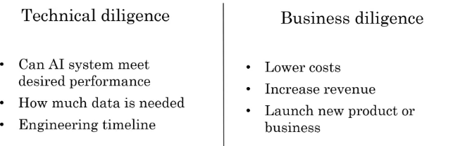

Slide 82
Ethical diligence
Is this going to make society better?
Notes:
Voting →
The great hack→ trump election jeeta
Cambridge analytica→

Slide 83
Build Vs Buy
ML projects can be inhoused or outsourced
DS projects are generally inhoused
Buy industry standard, only build specialized products
Notes:
Finance→ retail→
Amazon, Alibaba→

Slide 84
How to work with AI team
Specify your acceptance criteria
95% accuracy
Training, validation and Test dataset
Don’t expect 100% accuracy
Limitations of ML
Insufficient data
Mislabeled data
Ambiguous labels (human perception)

Slide 85
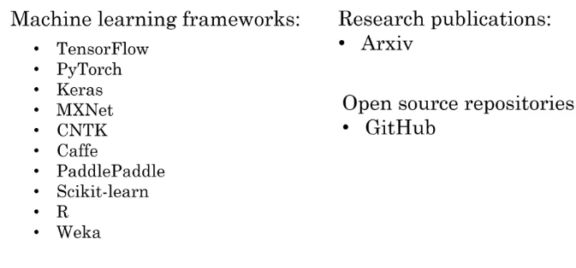
Machine Learning frameworks

Slide 86
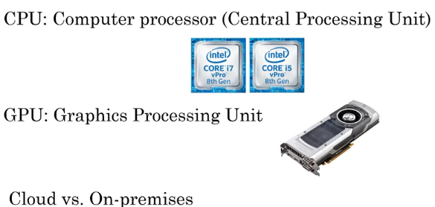
CPU Vs GPU
Edge Deployment
Notes:
CPU stands for Central Processing Unit.While GPU stands for Graphics Processing Unit.2.CPU consumes or needs more memory than GPU.While it consumes or requires less memory than CPU.3.The speed of CPU is less than GPU’s speed.While GPU is faster than CPU’s speed.4.CPU contain minute powerful cores.While it contain more weak cores.5.CPU is suitable for serial instruction processing.While GPU is not suitable for serial instruction processing.6.CPU is not suitable for parallel instruction processing.While GPU is suitable for parallel instruction processing.7.CPU emphasis on low latency.While GPU emphasis on high throughput.

Slide 87
Case Studies

Slide 88
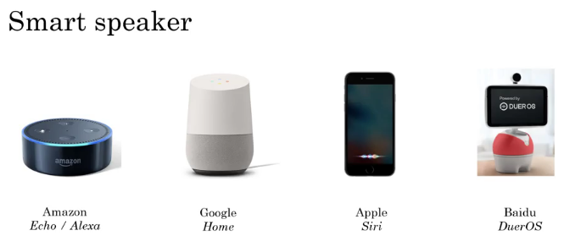

Slide 89
Steps or AI pipeline
Trigger word: Hey Device
Speech Recognition: Tell me a joke
Intent Recognition: joke, time, music, weather
Log of training instances, variation in text
Execute joke

Slide 90
Activity
Hey device, set timer for 10 minutes
What is the intent?
Extract duration
What command is to execute

Slide 91
Smart speaker functions
Play music
Volume up/ down
Make call
Current time
Units conversion
Simple question
These specialized execution routines are written by software engineer

Slide 92
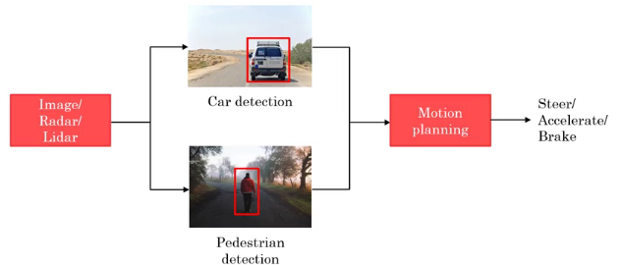
Self driving car

Slide 93
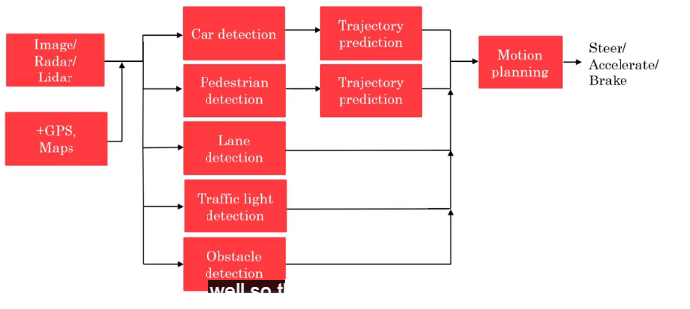

Slide 94
AI teams
AI team may have 100s of engineers
A small team can have four or five members
Example roles
Software Engineers
Execute joke, Set timer
Machine Learning Engineer
Machine Learning Researcher
Extend state-of-the-art
Applied ML scientist in between ML researcher and ML Engineer
Data Scientist
Provide insights

Slide 95
Data Engineer
Organize data
Data is saved in cost effective way
We have lot of data, scalability is important
AI Product Manager
What to build and feasible

Slide 96
Get started with a small team
1 Software engineer
1 ML engineer / Data scientist
No body but your self

Slide 97
AI Transformation playbook
Execute a pilot project to gain momentum
Build an in-house AI team
Provide broad AI training
Develop an AI strategy
Develop internal and external communication

Slide 98
Execute pilot project
Start the fly wheel
Show traction with in 6-12 months
Can be in-house or out-sourced

Slide 99
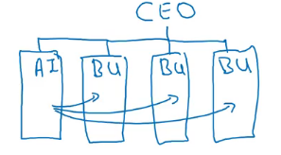
Build an in-house AI team
Develop tools that could be useful company wide
Under CIO, CTO,CDO, CAIO

Slide 100
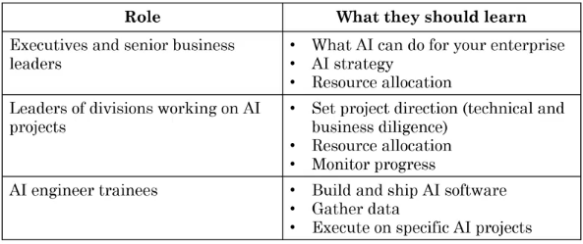
Provide broad AI training

Slide 101
Resources
Online courses
Books
Curate rather than create content

Slide 102
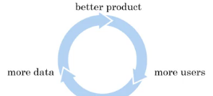
Develop an AI strategy
Leverage AI to create an advantage specific to your company
Design strategy that align with virtuous cycle of AI
Blue River – precision agriculture

Slide 103
AI needs to be specialized or verticalized to your industry sectory
Don’t compete with giants
Creating a strategy
Strategic data acquisition
Unified data warehouse – Pull data into single repository, software can connect the dots
Create network effect and platform advantages
Uber, Careem, Facebook

Slide 104
Low cost strategy
High value strategy

Slide 105
Develop internal and external communications
Investor relations
Government relations
Consumer / user education
Talent / recruitment
Internal communication

Slide 106
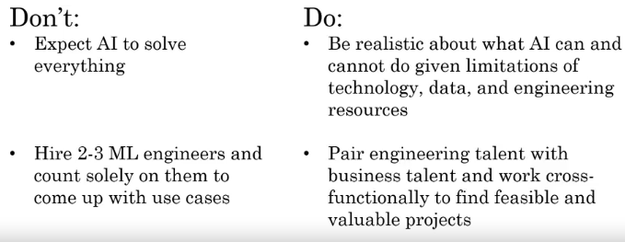
Common pitfalls

Slide 107
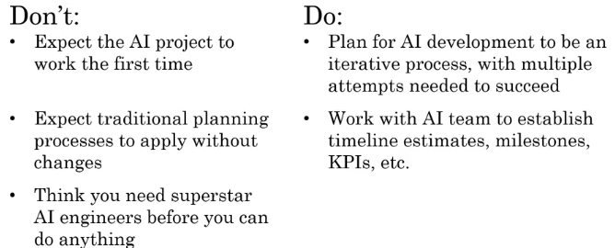

Slide 108
Take your first step
Get friends to learn about AI
Start brainstorming projects
Hire a few ML / DS to help
Hire or appoint an AI leader (VP AI, CAIO)
Discuss with CEO about possibilities of AI transformation

Slide 109
AI Application areas
Computer Vision
Image Classification / Object recognition
Face recognition
Object detection
Image segmentation
Tracking

Slide 110
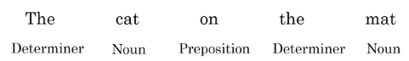
Natural language processing
Text classification (Spam / Non spam)
Sentiment recognition
Information retrieval
Web search
Named entity recognition
Machine translation
Part of speech tagging

Slide 111
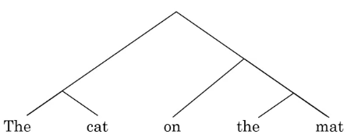
Parsing

Slide 112
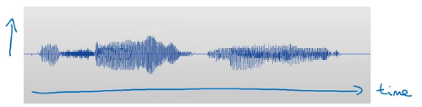
Speech
Speech to text
Trigger / wake word detection
Speaker ID
Speech synthesis (text-to-speech / TTS)

Slide 113
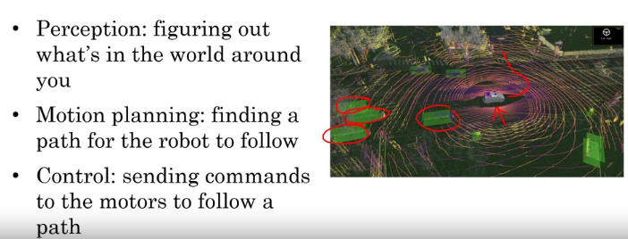
Robotics

Slide 114
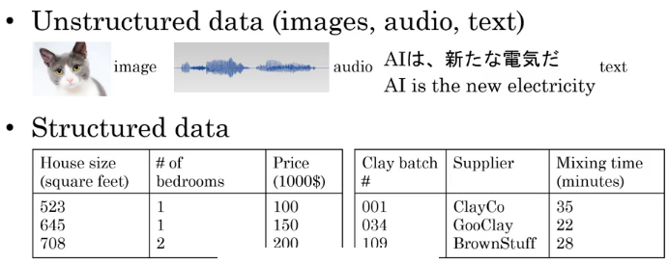
General machine learning

Slide 115
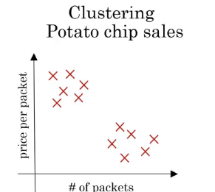
Unsupervised learning

Slide 116
Supervised learning needs lot of data
10,000 defected coffee mug, human can easily do that with few examples

Slide 117
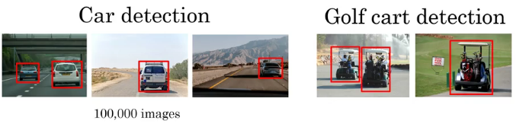
Transfer learning

Slide 118
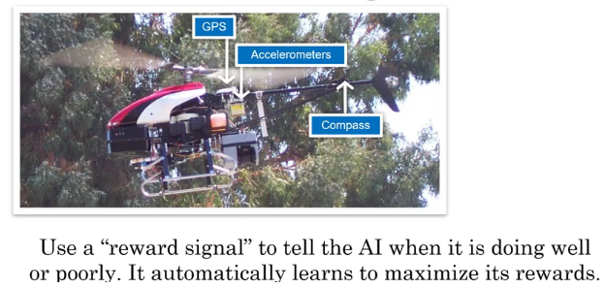
Reinforcement learning
Also useful in Games
Not as much as economic value as supervised learning

Slide 119
Generative Adversarial Network (GAN)
Synthesize new images from scratch
Entertainment industry, film, animation

Slide 120
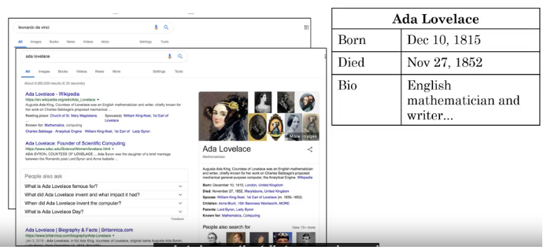
Knowledge graph

Slide 121
AI & Society
AI is super power
Goldilock rule
Neither too optimistic nor pessimistic
Don’t over spend on unnecessary danger
AI winter
AI can’t do every thing, but will transform industries

Slide 122
Limitations of AI
Performance limitations
With small amount of data
Explainability is hard (sometimes doable): How should we trust
Humans are also not good at explaining
Barrier to acceptance
Biased through biased data
Adversarial attacks

Slide 123
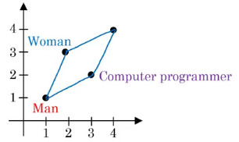
AI can learn unhealthy stereotype
Learn from internet
Man: Woman as Father: Mother
Man: Woman as King: Queen
Man : Computer programmer as women: Home maker
Man and woman can equally become programmer

Slide 124
Why bias matters
Hiring tool that discriminates against woman
Facial recognition working better for specific ehtnicity
Bank loan approavals
Toxic effect of reinforcing unhealthy stereotypes

Slide 125
Combating bias
Technical solution
Zero out bias
Use less biased or more inclusive data
Transparency or auditing process
Diverse workforce
Creates less biased applications

Slide 126

Adversarial attacks
Spam Filters
Hate speech filter

Slide 127

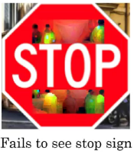
Physical attacks

Slide 128
Adversarial defenses
Cost to defend
Slow speed
May not be any incentive to attack, so should we invest in defense?
Zero-sum against adversaries

Slide 129
Adverse uses of AI
Deep Fakes
Synthesizing videos
Video of Obama
Undermining of democracy and privacy
Oppressive surveillance
Generating fake comments
Spam Vs anti-spam, Fraud Vs anti-fraud

Slide 130
AI & Developing economy
Developing economies gradually moved up the ladder
Lower end ladder are susceptible to automation such as agriculture
Trampoline to move higher rungs
Leapfrog
Example of mobile phone
Mobile payments
Online education

Slide 131
How developing economies can build AI?
US and China leading
But AI communities are still immature
Focus on AI to strengthen country’s vertical industries
Instead of focusing on AI in general, use AI where you are already good at
Public private partnership
Invest in education

Slide 132
AI and impact on jobs
AI is automation on steroids
Jobs displaced by 2030
400-800 mn
Jobs created by 2030
555- 890 mn
Is your job amenable to automation?

Slide 133
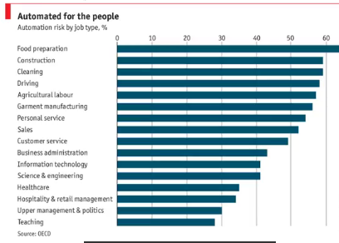

Slide 134
Some solutions to counter AI impact on jobs
Conditional basic income: provide a safety net
Life long learning society
Political solutions
Legalization
Work at intersection of your current joband AI

Slide 135
Summary
What is AI?
Building AI projects
Building AI in your company
AI & society

